Slide 1
Bank Loan Analysis
Objective : To perform analysis of bank loan data with visualizations using Excel and Tableau. KPIs implementation and Dashboard presentation with inferences.
By:
Spurthi Y. D.
Prabhu
Aishwarya Janardhan Patil
Utpal Patil
Akash Bajinath Rajbhar
Mohsin Niaz Shaikh
(Jan – Feb 2022)

Slide 2
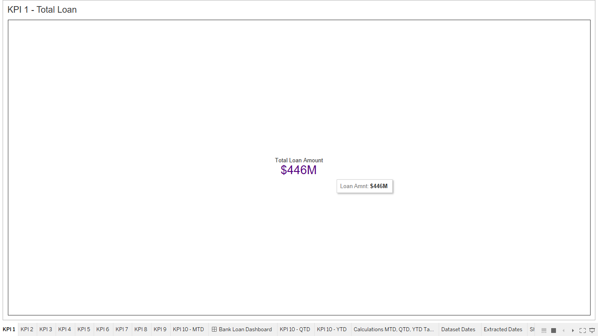
KPI 1 - Total Loan
Snapshot:
Inference:
From the above KPI image, we can see the Total Loan Amount is $446M.

Slide 3
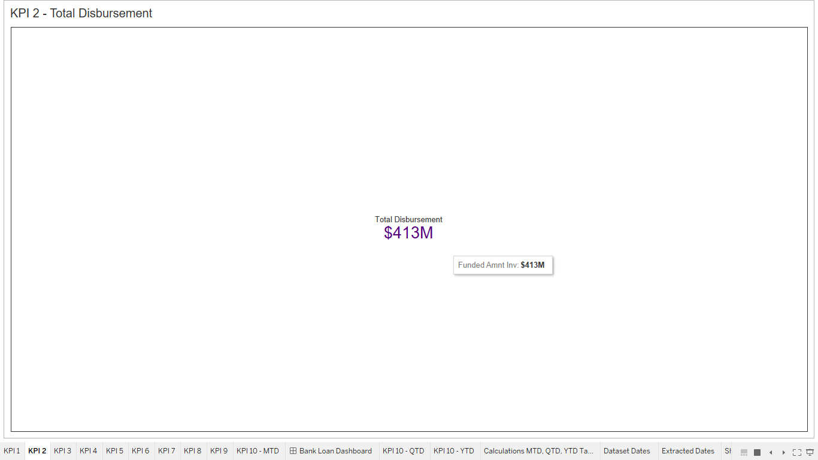
KPI 2 - Total Disbursement
Snapshot:
Inference:
From the above KPI image, we can see the Total Disbursement Amount is $413M.

Slide 4
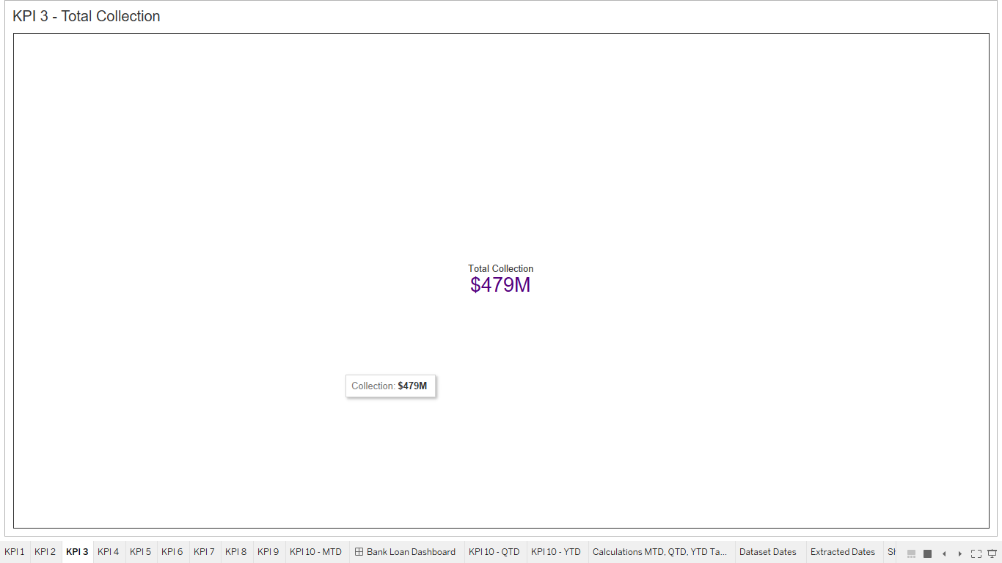
KPI 3 - Total Collection
Snapshot:
Inference:
From the above KPI image, we can see the Total Collection Amount is $479M.

Slide 5
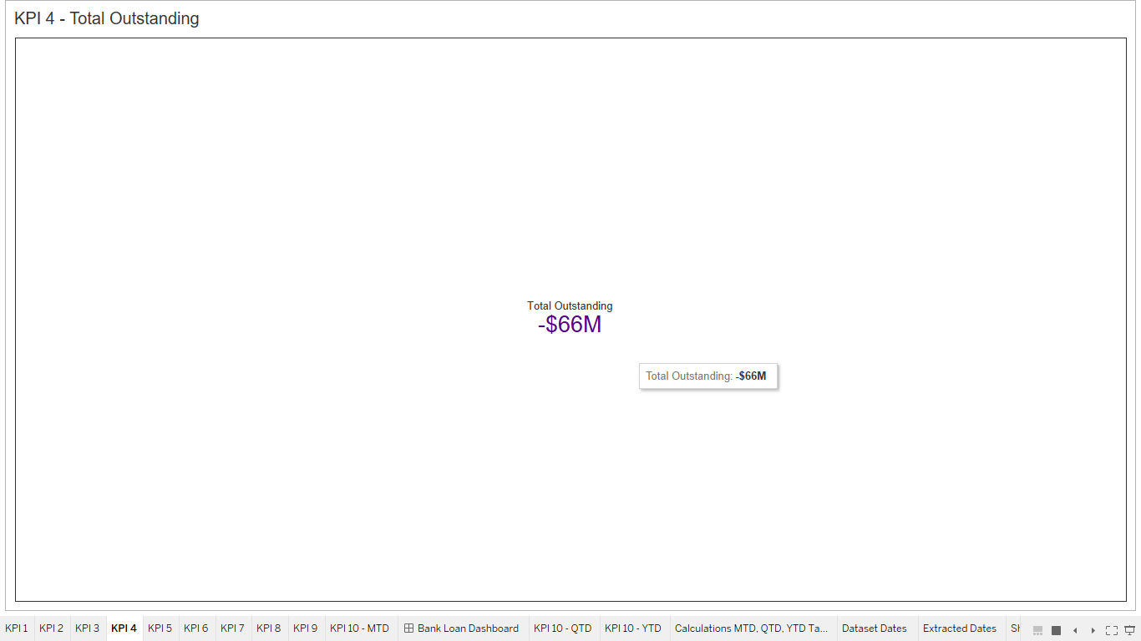
KPI 4 - Total Outstanding
Snapshot:
Inference:
From the above KPI image, we can see the Total Outstanding Amount is -$66M.
Because the Total Collection amount is more than the Total Disbursement amount, we get negative value for Total Outstanding amount.

Slide 6
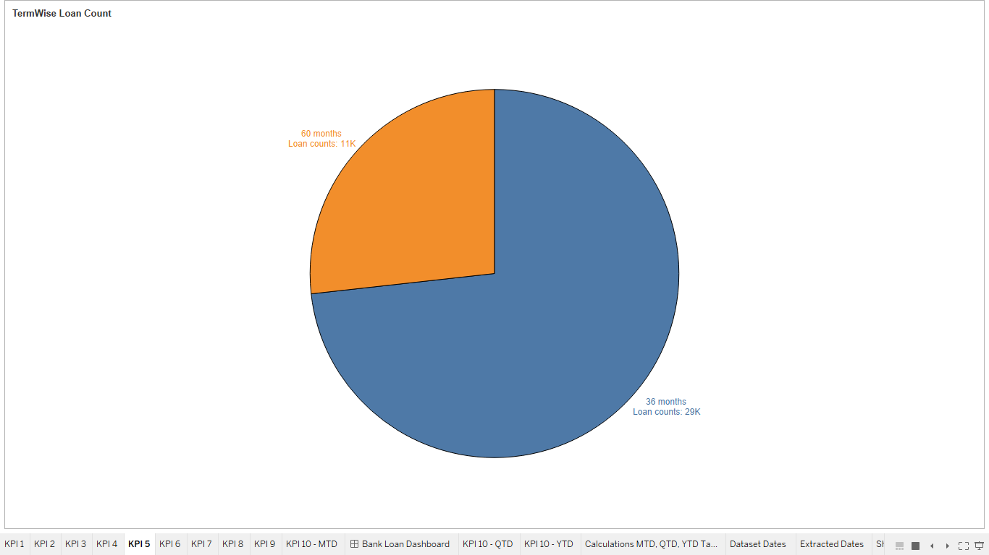
KPI 5 – Term Wise Loan Count
Snapshot:
Inference:
We can see, the count for the term of 36months is quite larger than the count of loans for the term of 60months. Respective count for both the terms is 29K and 11K.

Slide 7
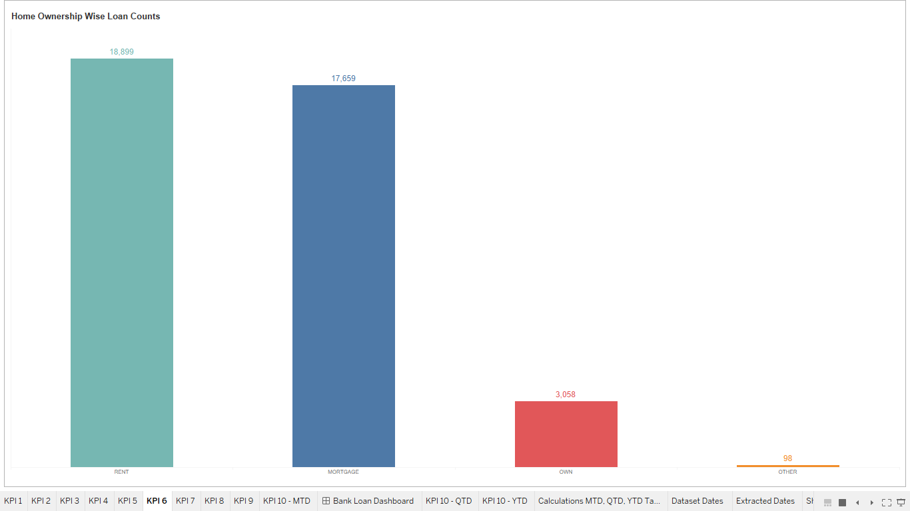
KPI 6 – Home Ownership Wise Loan Count
Snapshot:
Inference:
Count for each category is mentioned in the above KPI image. It clearly indicates that the count for the RENT category is highest than the other all categories.
Category wise counts are as below:
RENT – 18,899
MORTGAGE - 17,659
OWN – 3,058
OTHER - 98

Slide 8
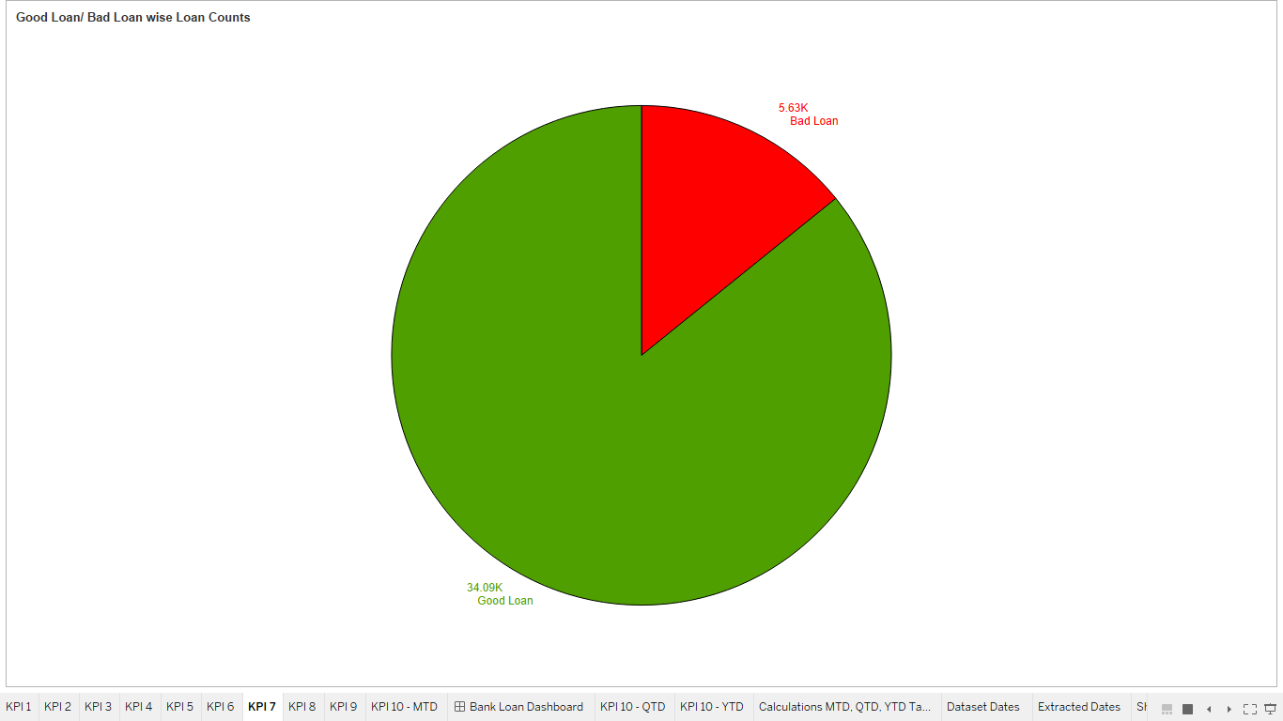
KPI 7 – Good Loan / Bad Loan Wise Loan Count
Snapshot:
Inference:
We get positive insights from the above KPI image, as the count for the Good Loan is much larger than the count for the Bad Loan.
Good Loan Count : 34.09K
Bad Loan Count : 5.63K

Slide 9
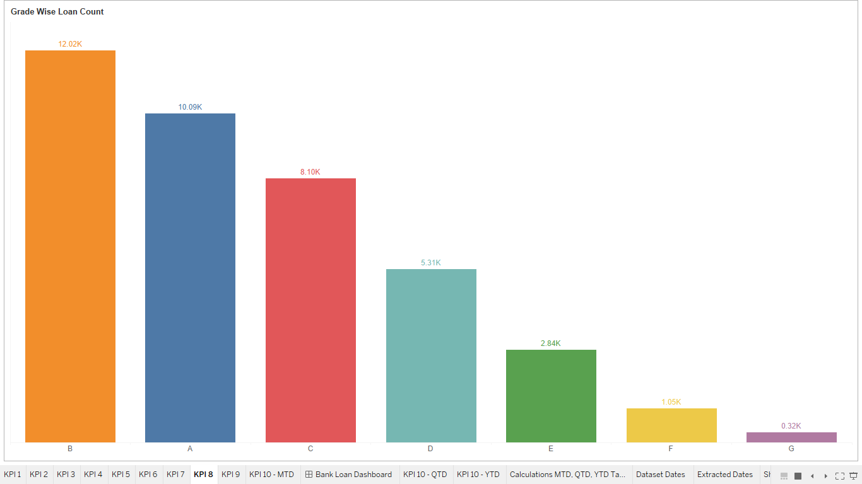
KPI 8 – Grade Wise Loan Count
Snapshot:
Inference:
Count of Loans for each grade is displayed in the above KPI image. We can see that, count of loans for Grade B is highest and count of loans for Grade G is lowest amongst all other grades.

Slide 10
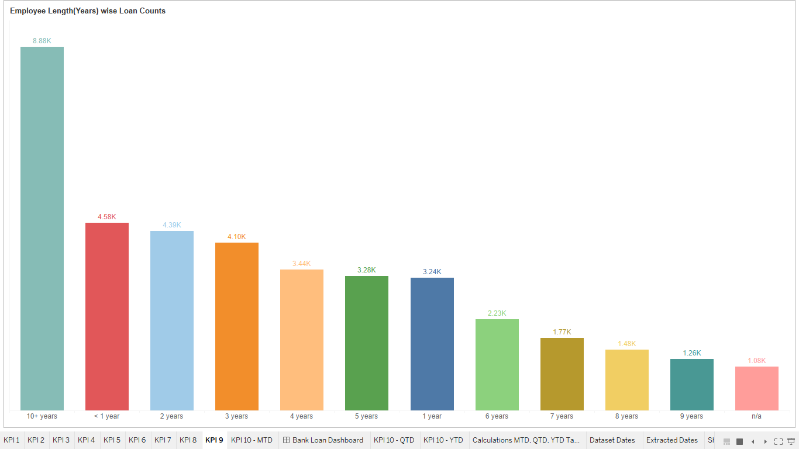
KPI 9 – Employee Length(in Years) Wise Loan Count
Snapshot:
Inference:
Above bar graph shows the loan count for each Employee Length. Highest loan count is for 10+Years of Employee Length, followed by the loan count for <1Years of Employee Length and so on.

Slide 11
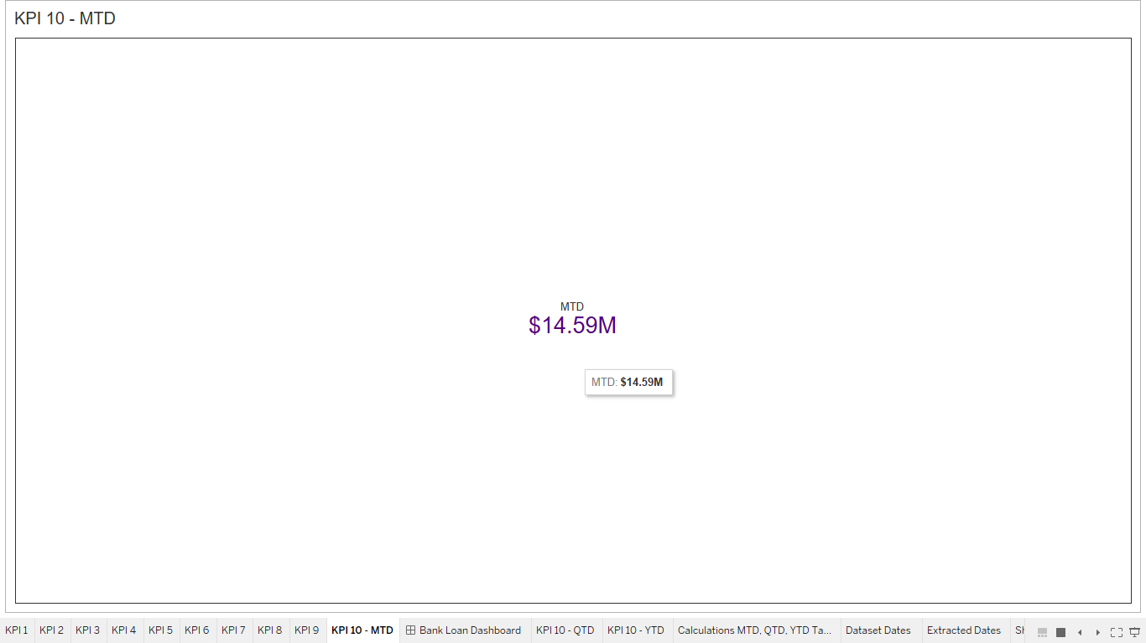
KPI 10 – MTD
Snapshot:
Inference:
MTD(Month to Date) value for the Loan Amount is $14.59M for the year(2011).

Slide 12
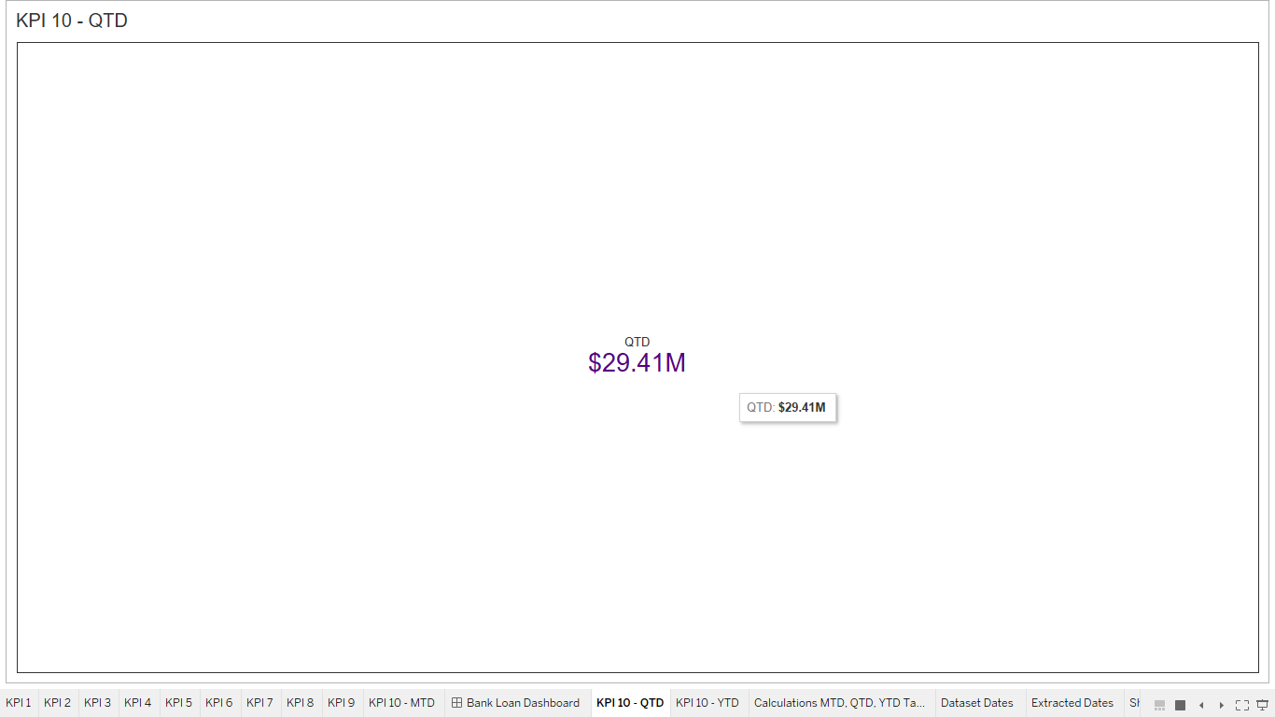
KPI 10 – QTD
Snapshot:
Inference:
QTD(Quarter to Date) value for the Loan Amount is $29.41M for the year(2011).

Slide 13
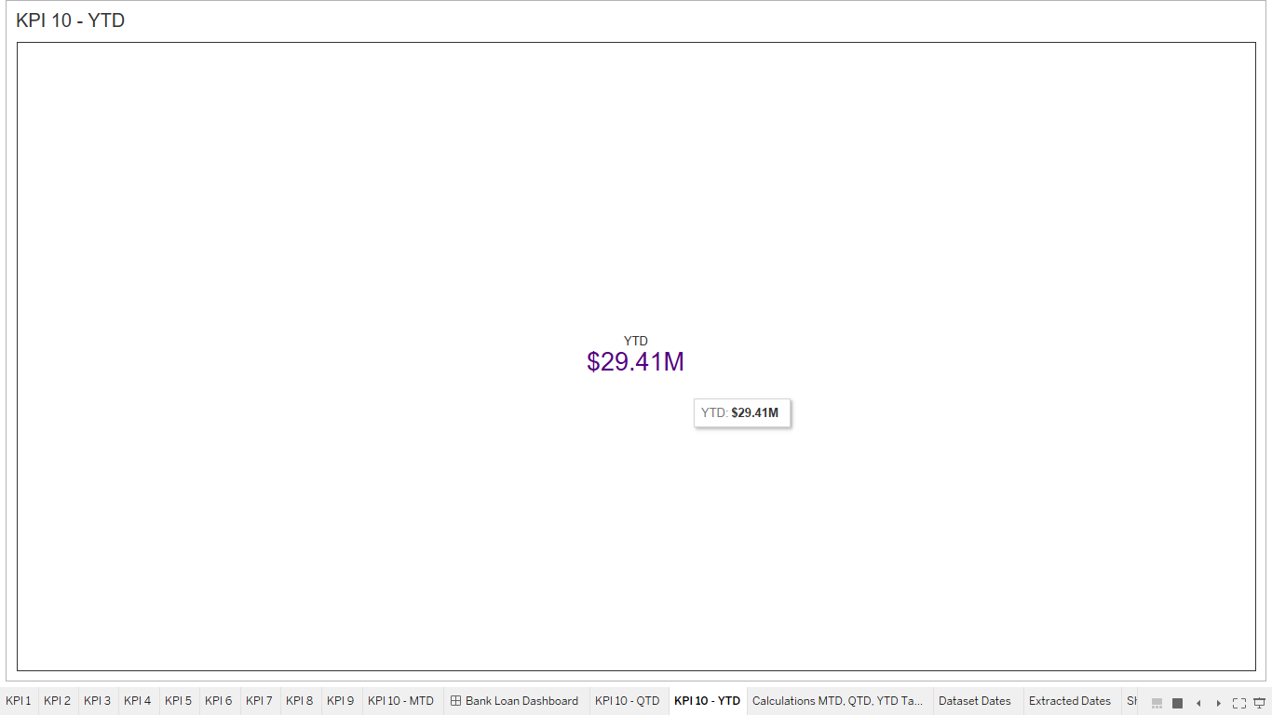
KPI 10 – YTD
Snapshot:
Inference:
YTD(Year to Date) value for the Loan Amount is $29.41M for the year(2011).

Slide 14
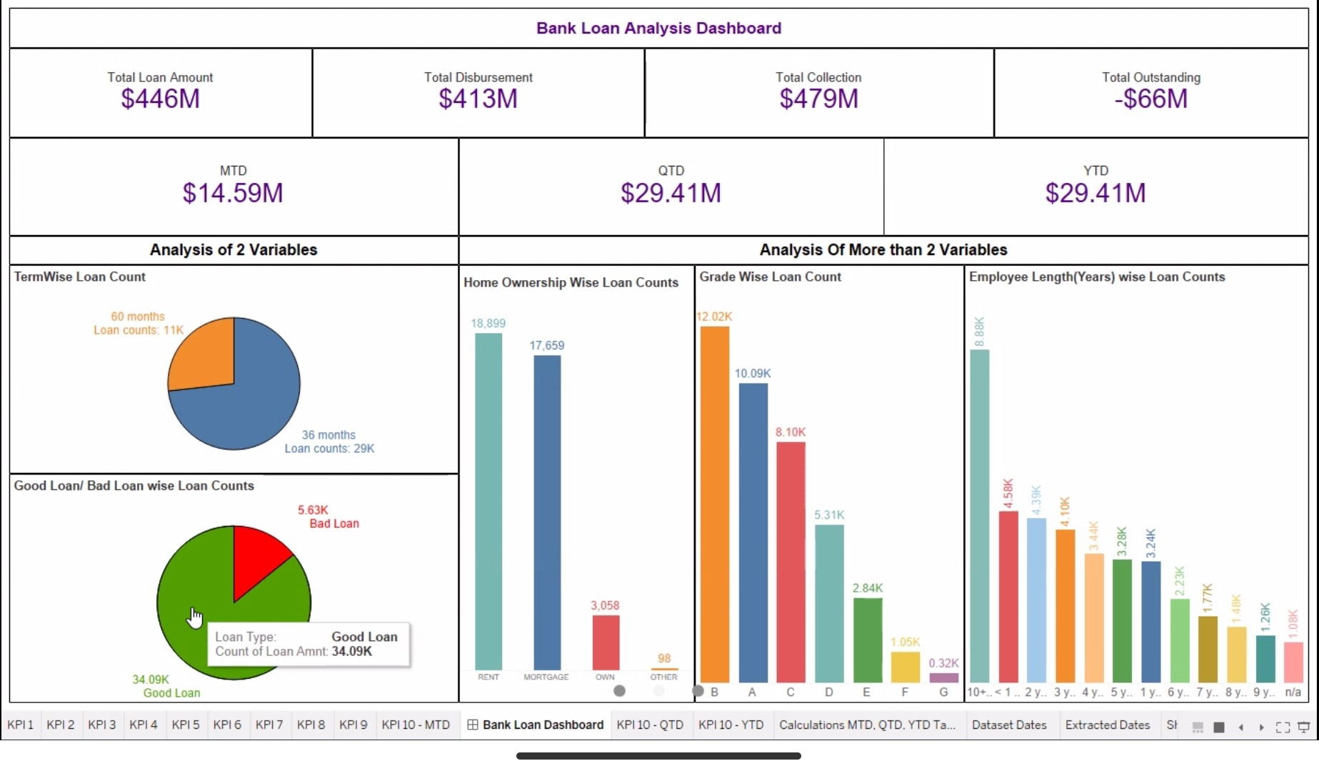
Bank Loan Analysis Dashboard
S
N
A
P
S
H
O
T
Analysis between different variables of the bank loan data is represented by the above Tableau Dashboard.

Slide 15
Conclusion
From this Bank Loan Analysis,
We first figured out important key performing indicators like Total Loan, Total Disbursement, Total Collection, and Total Outstanding amounts.
Secondly, the different analysis between the important variables is shown with pie charts(2 variables) and bar graphs(more than 2 variables.)
Prime key performing indicators for the bank – MTD, QTD, YTD values of loan amounts are calculated and added in the dashboard at the top.

Slide 16
Thank You

